Slide 1

CUI Abbottabad
Department of Computer Science
SRE
19
Event Response Table

Slide 2
Outline
Swimlane Diagram
https://www.lucidchart.com/pages/tutorial/swimlane-diagram

Slide 3
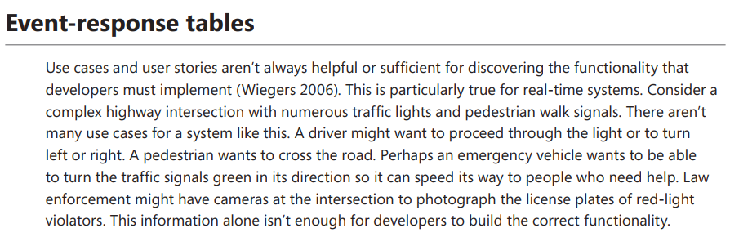

Slide 4
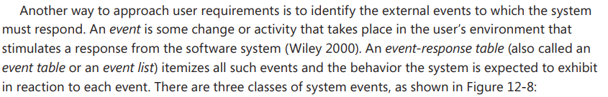

Slide 5

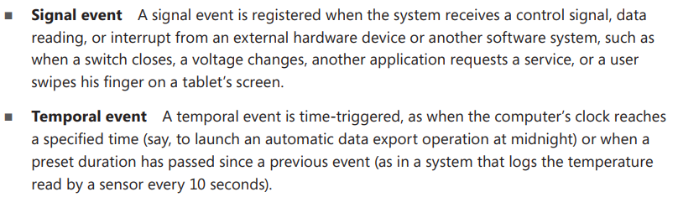

Slide 6
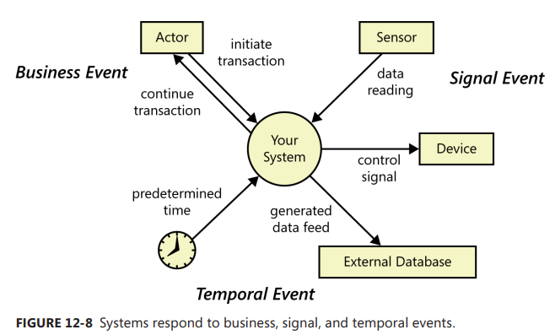

Slide 7
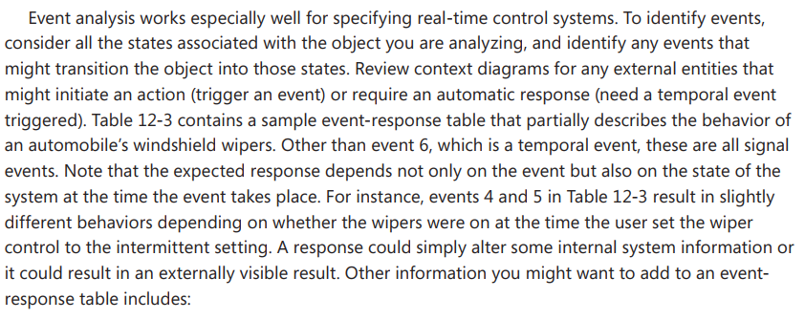

Slide 8
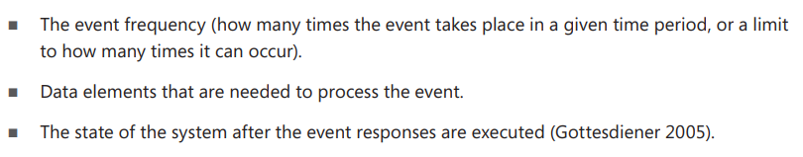

Slide 9
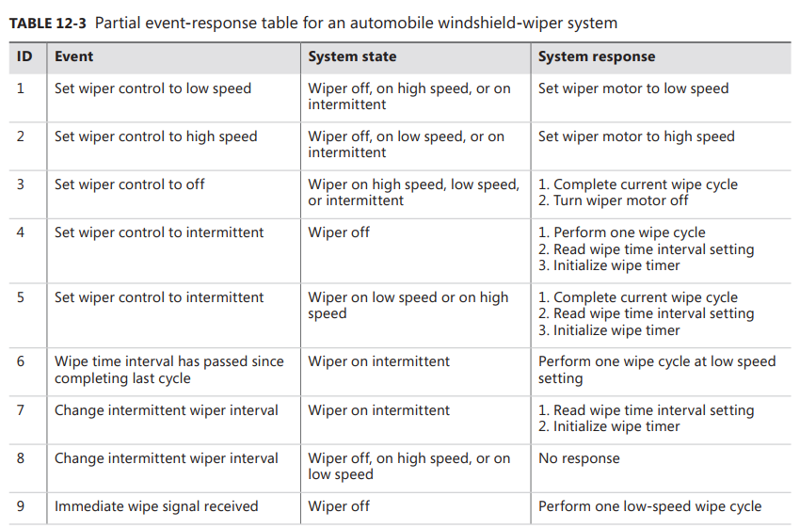

Slide 10
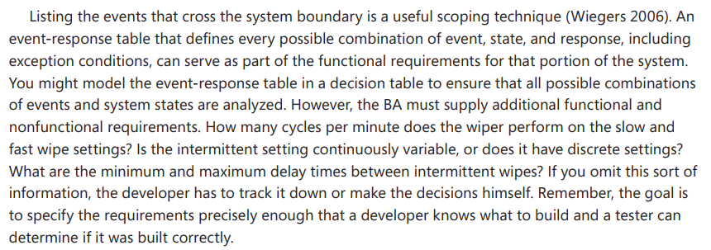

Slide 11
